Slide 1

Age and Cybersecurity
By Harry Skidmore

Slide 2
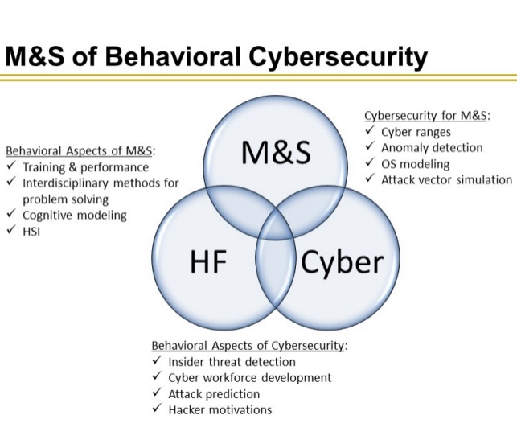
Cybersecurity Model
Notes:
For the project I selected the Behavioral Aspects of Cybersecurity and find that it doesn’t account for Aging and it’s effects on cybersecurity and behavior.

Slide 3
Population Facts
People are living longer then ever in history (Fisk et al. 2020).
By 2050 people over the age of 80 will account for 20% of the population (Fisk et al. 2020).
People are currently working past retirement age (Fisk et al. 2020).
Increase in technology use among older adults (Fisk et al. 2020).
More older adults are suspectable to cyberattacks and scams then younger groups (Fisk et al. 2020).
Notes:
Across the world people live longer, and the aging population continues to increase each year. This population is often ignored by human factors. By 2050, people over the age of eighty will account for 20% of the world population. People are currently working past their age of reitrment and will continue to work. Over 49% of adults over the age of sixty are using computers. Many older adults

Slide 4
Different parts of aging
Neurological (Fisk et al. 2020)
Physiological (Morrison et al. 2020)
Psychological (Morrison et al. 2020)
Socioeconomical (Morrison et al. 2020)
Notes:
Neurological Issues include, memory issues, and can make older people highly suggestible to cyberattacks such as phishing emails ect. Physiological issues parts of aging often deal with the break down of the body and development of painful issues such as arthritis can be distractions and increase the chances of cyberattacks. Psychological effects such as feeling and being more isolated and seeking friends through social media, putting them at risk for social media attacks.

Slide 5
Conclusion
Cybersecurity needs to account for older population and the effects aging has on behavior.
Population is growing and will continue to grow
Notes:
Cybersecurity needs to account for older population and the effects aging has on behavior as the population is growing and continues to grow.

Slide 6
references
References
Fisk, A. D., Czaja, S. J., Rogers, W. A., Charness, N., & Sharit, J. (2020). Designing for older adults: Principles and creative human factors approaches. CRC press.
Morrison, B. A., Coventry, L., & Briggs, P. (2020). Technological change in the retirement transition and the implications for cybersecurity vulnerability in older adults. Frontiers in
psychology, 11, 623.

